Slide 1

Learning Assessment Research Consortium (LARC) Professional Development Modules Available through NILOA
Chris Cratsley, Fitchburg State University Jennifer Herman, Simmons University

Slide 2

Today’s Agenda
Project Background
Overview of the NILOA website and Modules
Module Highlights
  Assessment Benefits and Barriers
  Using Assessment Data
Questions and Discussion of
Applicability to Your Institution

Slide 3







Project Background
Phase 1: Establishing Consortium and Analysis of Assessment Education Needs

Slide 4
Project Background & Process
Phase 2: Design/Development of Curriculum & Website
Six modules with many sub-modules Basic to Advanced
Customizable curriculum Range of audiences
Website: https://www.learningoutcomesassessment.org/Browse-by/New-to-Assessment/

Slide 5
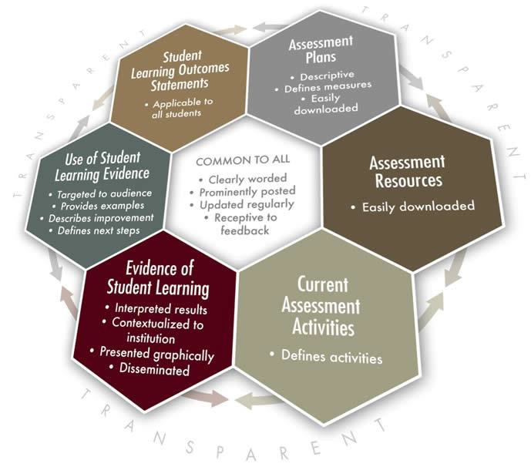
Project Background & Process
Phase 3: Final Steps and Dissemination
Pilot Testing Revisions Scholarship Open Source
NILOA Partnership
http://www.learningoutcomesassessment.org

Slide 6
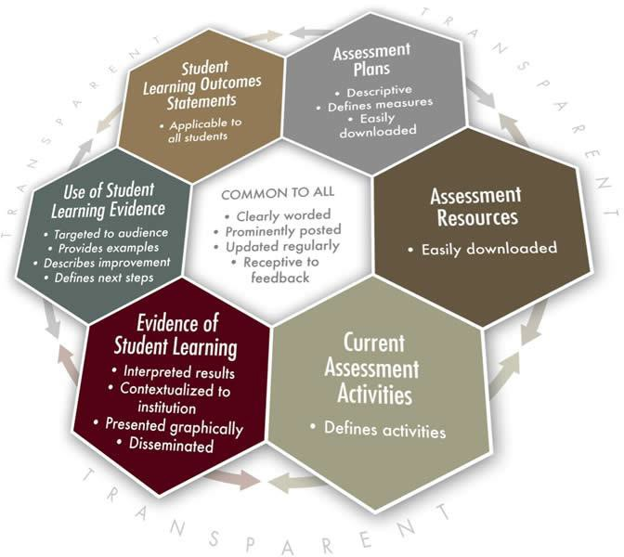




Phase 4: Available Online Now https://www.learningoutcomesassessment.org/Browse-by/New-to-Assessment/
Assessment Benefits and Barriers
Demystifying Assessment
Goals and Objectives
Gathering Assessment Data
Using Assessment Data
Developing Sustainable Practices

Slide 7
Examples & Activities
Beta-tester feedback:
Benefits and Barriers: “clear and consumable”, “great design”
Goals and Objectives: “Activities were really insightful, and applies what was being learned in this section”, “The questions are direct and to the point...”.
Demystifying Assessment: "The activities provide clear take aways for my work and structures", “clear and easy to understand” “Very helpful to have the worksheets…” “I liked the activities broken down into steps and all the worksheets that were provided.”
Gathering Data: “I thought the readings were good, and the system approach was effective.”

Slide 8
Examples & Activities
Beta Tester feedback continued:
Using Assessment Data: "I found the information, especially in the section about closing the loop to be very helpful. I plan on using it to enhance the way I use assessment data.” “There is some fabulous content here – well done!” “This is a very nice combination of activities…”
Developing Sustainable Practices: "I enjoyed the variety of formats allowing for multiple learning styles."

Slide 9
Sample Online Materials: Assessment Benefits and Barriers

Slide 10
Sample Online Materials: Using Assessment Data

